Slide 1
Introduction to the R statistics R Environment
Raman Sharma
16/01/2020

Slide 2

R: What is it?
R is a programming language and a command-line environment for statistical computing and graphics.
Free to install and it works on Windows, MacOS and UNIX computer operating systems (i.e. it’s ‘multi-platform’).
R comes with a number of ‘base’ packages as standard, allowing you to manipulate, interrogate and plot data in common way.
Additional packages are written and made publicly available for free constantly on CRAN repositories.
Packages written by researchers to do particular and often very specialised analyses.
R can be used to carry out a huge variety of statistical and graphical techniques.

Slide 3
R: Why use it?
Free – you don’t need a licence.
Statistical methods and graphics are beyond ‘point and click’ packages e.g. excel, SPSS.
You can save a series of commands as a R script and re-use it multiple times, or modify it if the data changes.
Your R scripts are transferable to different computers/operating systems (after changing file paths).
Excellent for making high quality (‘publication-quality’) plots and graphics to present your data (as well as quick plots to explore and get a feel for your data).

Slide 4

Outline of The Course
Downloading R and R studio.
CRAN repositories.
Exercise 1: Creating datasets, reading in datasets in and exploring.
Exercise 2: Reading and manipulating in a complex dataset.
Exercise 3: Data exploration and plotting.

Slide 5
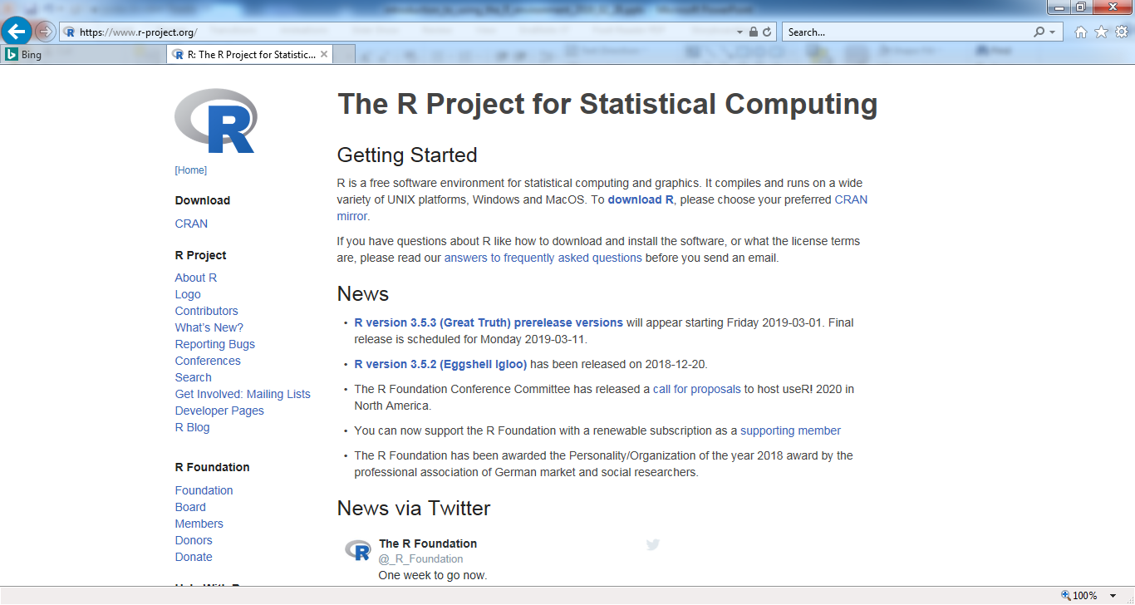
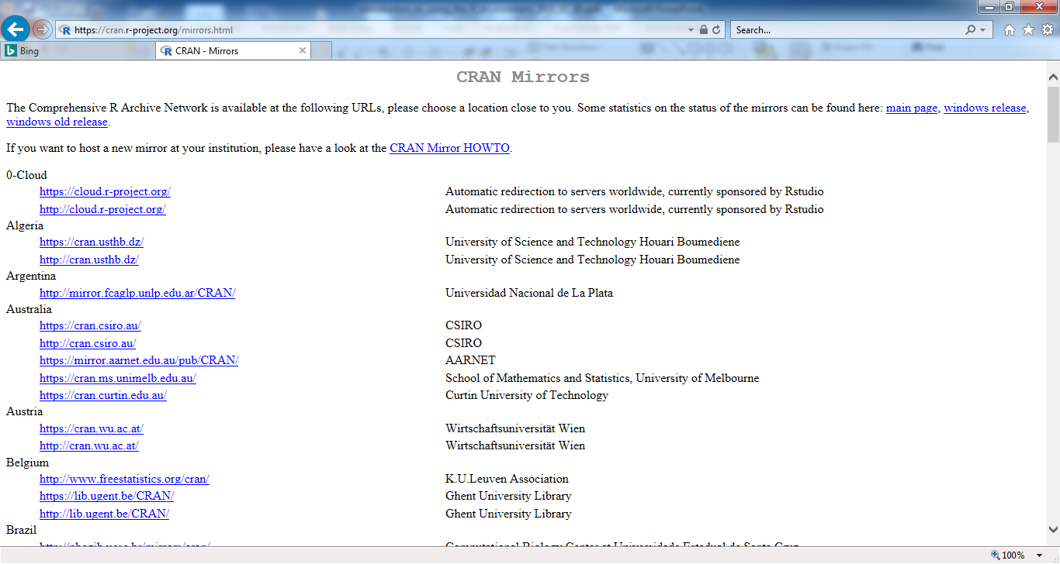
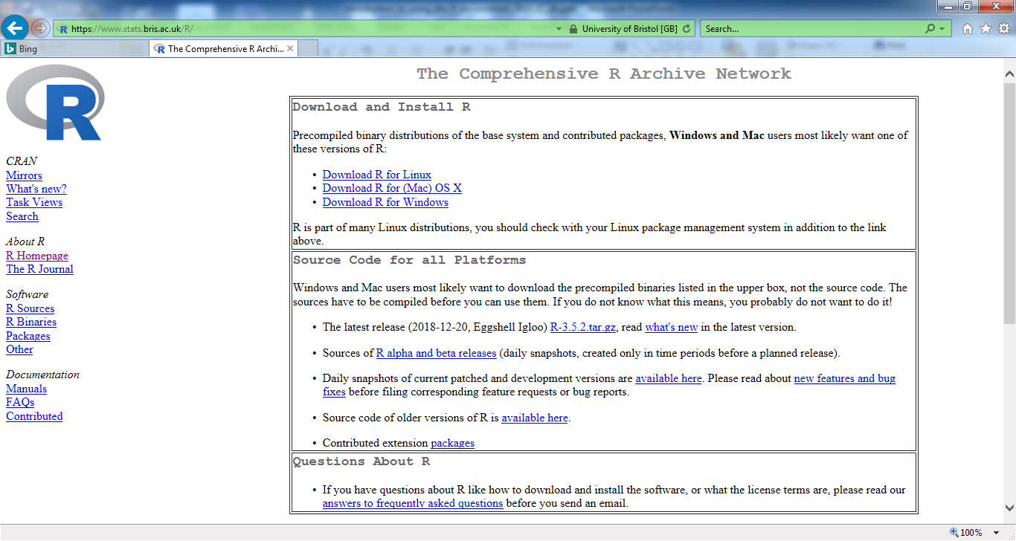
Downloading R:
https://www.r-project.org/

Slide 6
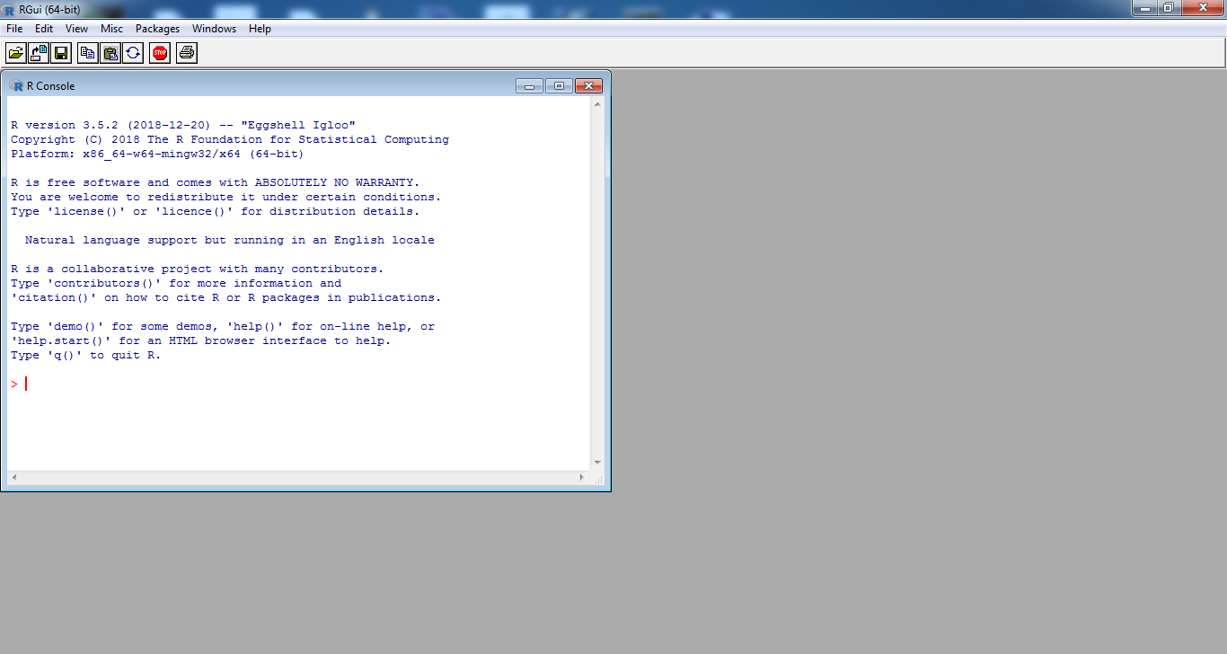
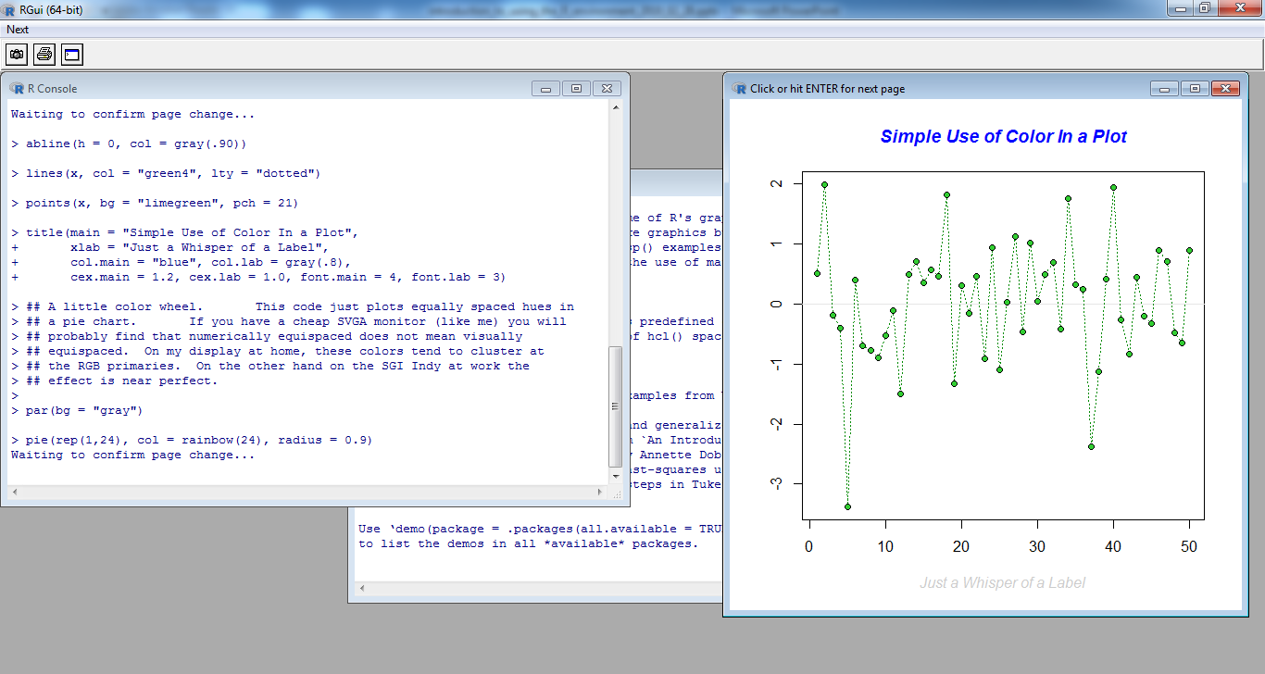
R Statistics Environment: Powerful although not pretty…

Slide 7

Rstudio: Making using R easier…
R is not a particularly smooth user experience if you don’t use an integrated development environment (IDE) such as Rstudio.
R can be:
Easy to make typing mistakes in, as there is no autofill/correct.
A little difficult to see where bugs are, as there are no pointers to them.
Hard to organise different windows such as plots, viewers and command line windows, as some have to be closed before carrying on.
Rstudio is “a set of integrated tools designed to help you be more productive with R. It includes a console, syntax-highlighting editor that supports direct code execution, and a variety of robust tools for plotting, viewing history, debugging and managing your workspace.”

Slide 8
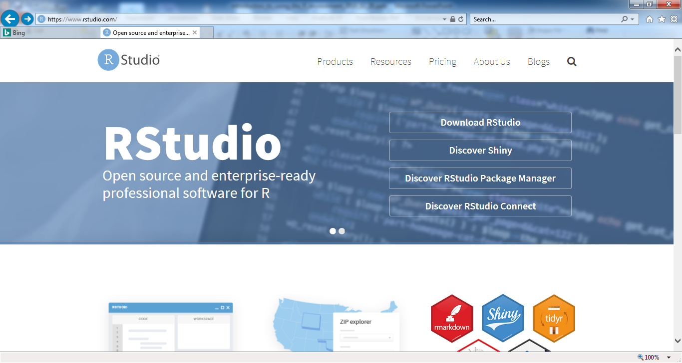
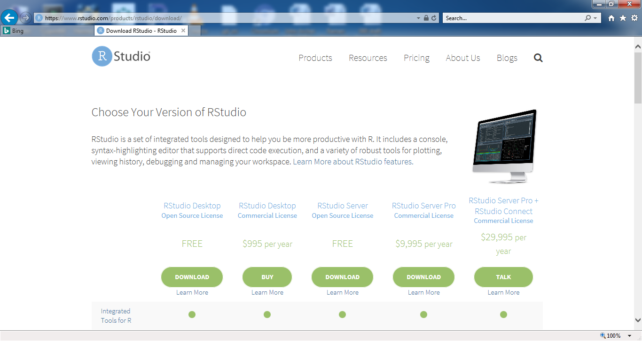
Downloading R Studio:
https://www.rstudio.com/

Slide 9
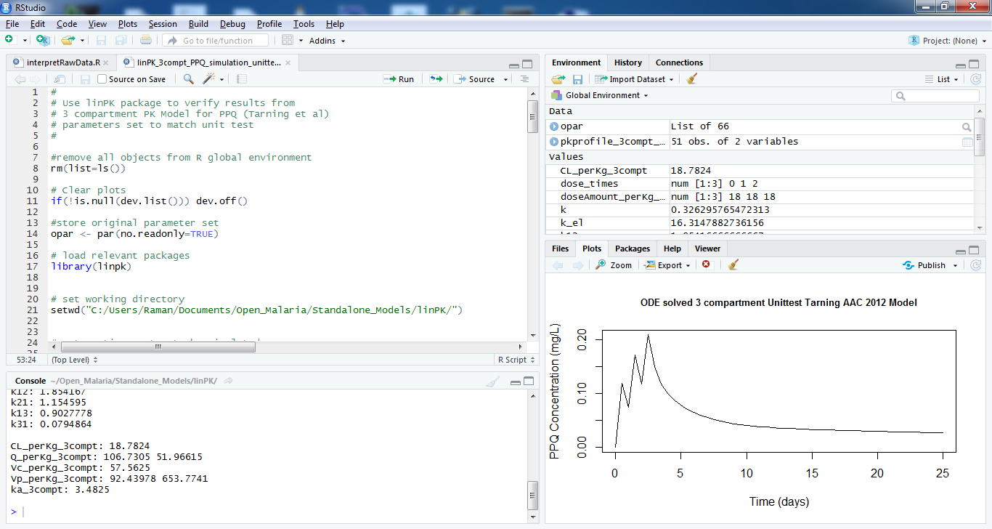
The Rstudio Interface
Script files tab
Saved objects and command history
Comments for later use
Plot panel
Command line console

Slide 10
Advantages of using Rstudio
RStudio is makes it easy to write scripts.
Autofills names of objects/variables.
Autofills arguments for library functions.
Convenient to view and interact with the objects stored in your environment in Rstudio.
“Environment” window shows all of the objects that you have stored.
RStudio facilitates setting your working directory and access files on your computer.
Navigate to folders on your computer in the “Files” window.
Graphics are easier to access in Rstudio.
Easily click back and forth between plots, change the sizes of your plot without rerunning the code.

Slide 11
CRAN Respositories…
Packages are collections of R functions, data, and compiled code in a well-defined format.
The folder where packages are stored is called the library.
R comes with a standard set of packages. Others are available for download and installation.
The Comprehensive R Archive Network (CRAN) is the main repository for R packages.
Mirror sites all over the world (e.g. Bristol, UK).
Use “install.packages()” function to install a package.

Slide 12
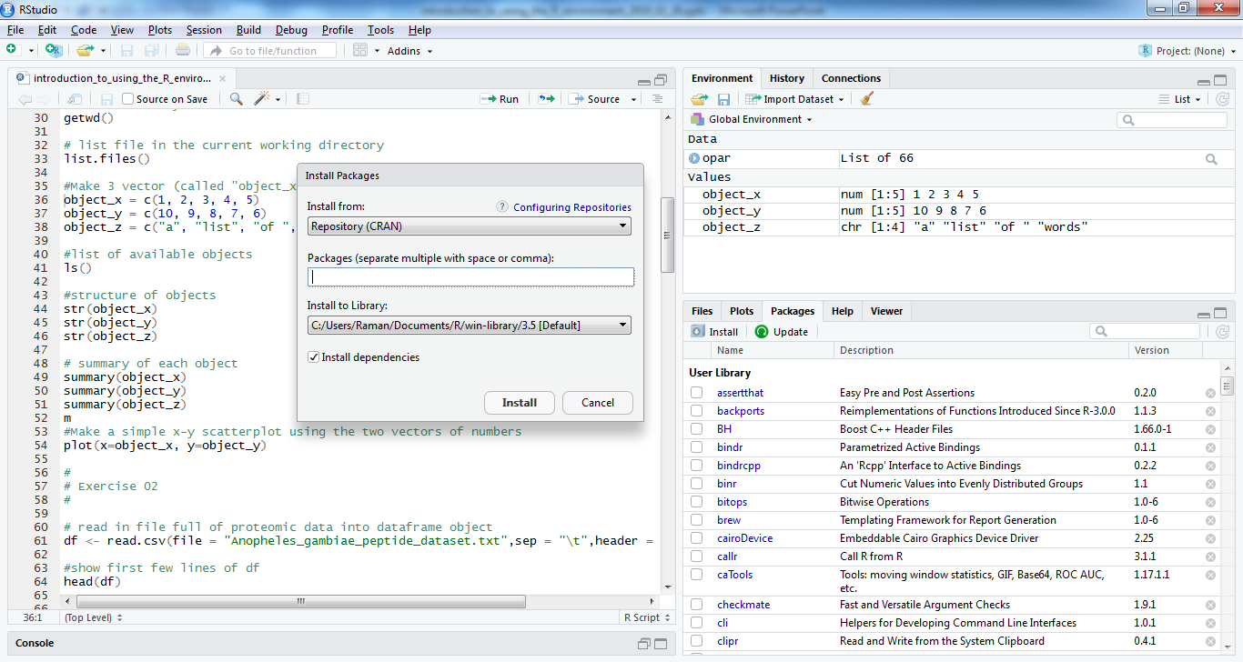
Can be installed using Package tab in Rstudio…
Packages tab

Slide 13
What are functions?
Functions are self-contained R pieces for code that usually do a specific task or set of tasks. Lots of functions in “base” R to do standard tasks.
You call a function my writing the function name with brackets:
> ls() # list all objects in R global environment
All functions produce an output; e.g. an R object (see object types later).
Some functions require data/information/settings (arguments) to produce output from (order only matters if you don’t name the argument):
> # plot(x=var_x,y=var_y,type=“b”) # plot var_x against var_y (not # executed)
Examples of functions are:
> setwd(“C:/Users/Raman/”) # set working direcrtory # set working dir > #myFahrenheit_to_Celsius(tempC = 10) # user-defined (not executed)

Slide 14
Why show you the command line way of doing things then?
Rstudio still uses these commands “under the hood”.
Most functions don’t have a “button” in Rstudio.
If you want to save them in a script and reuse them.
Sometimes quicker to perform command line operations, especially using tab to autofill or bring up syntax options.
Better to understand what is happening in case it isn’t doing what you want…

Slide 15
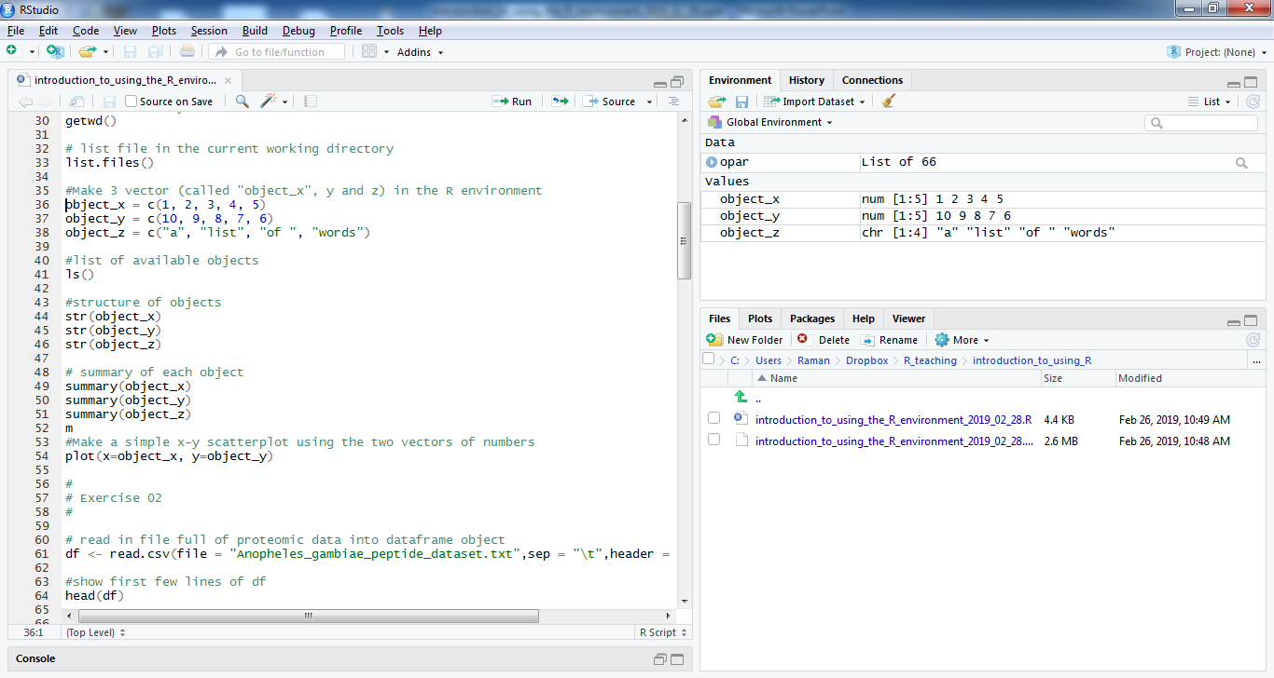
You can type all commands into a file and run from there…
-Place cursor on command line for execution and press “Run”
- You can highlight multiple lines for execution at one time.

Slide 16
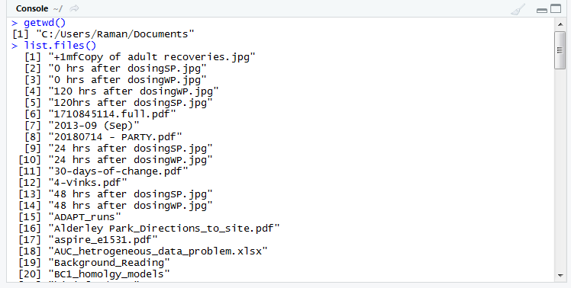
Exercise 1a: Create, examine and plot datasets: via command line.
In command line console/run from script to begin with (although you can a whole file too)…
Find out ‘where you are’ (what is the working directory) and what you can see (default folder that you will read from/write to):
> getwd()
> list.files()

Slide 17
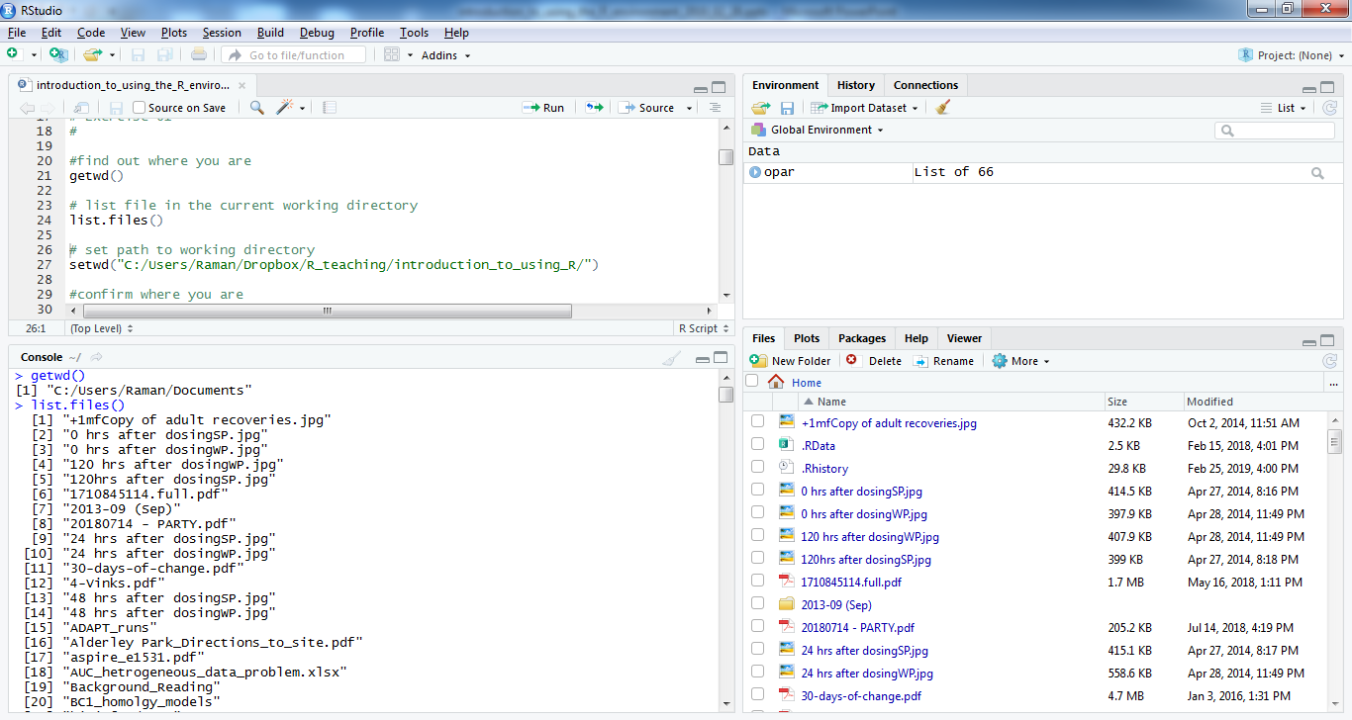
Displaying location and files…
Also you can view in folder contents
in files tab in Rstudio

Slide 18
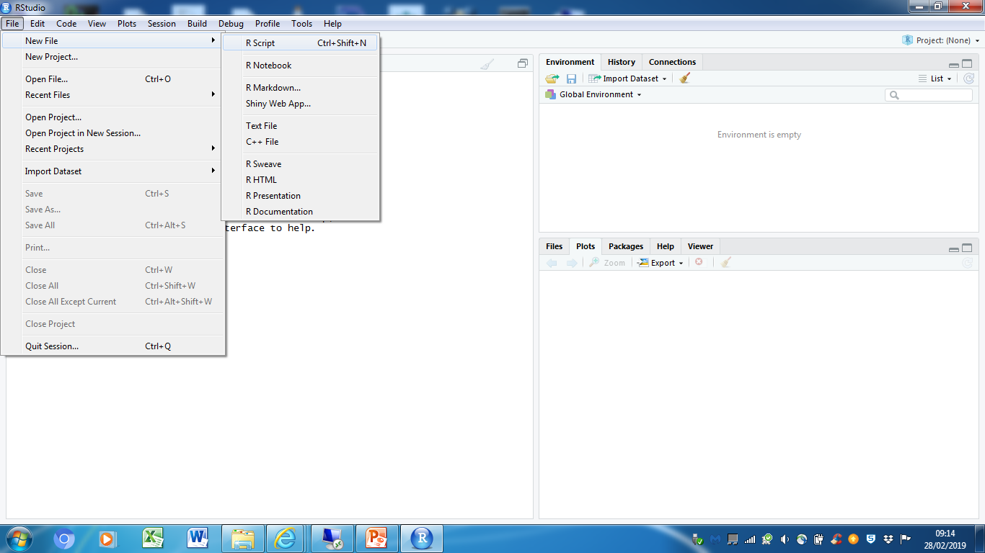
Creating an R script…

Slide 19
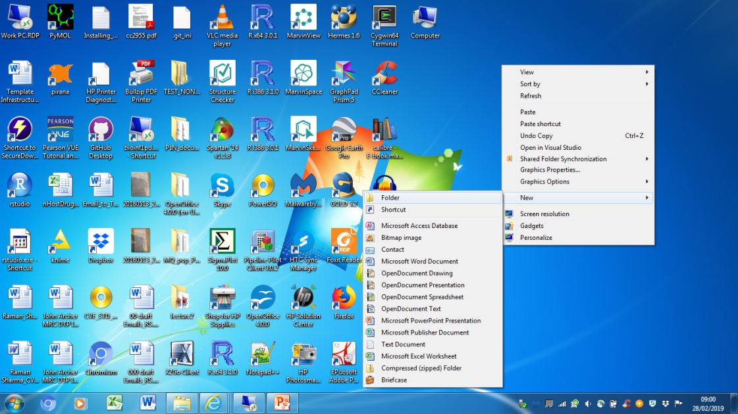
Create a folder to do all you R work in (Windows)
On Desktop -> [RIGHT CLICK] -> New -> Folder:
Click once on new folder (if name isn’t already highlighted) and renames as “R_intro_course”.
Download emailed files to this folder.

Slide 20
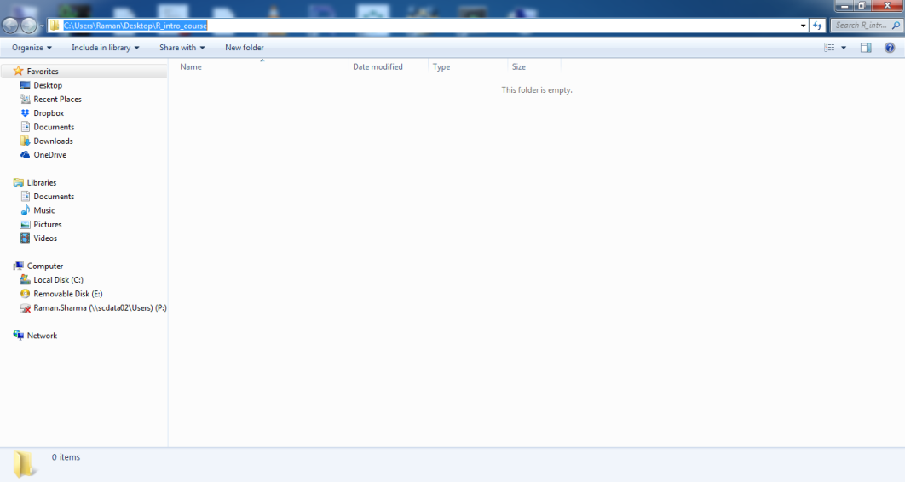
Finding working directory (Windows)
Change to working directory (the one you have just made) and see where you are now and folder contents…
Highlight path in “R_intro_course” folder and copy.

Slide 21
Create a Folder and Copy Path (Linux)
Navigate to you path:
cd “yourpath1”
Create directory (Linux name for folder):
mkdir “R_intro_course”
Get directory path (present working directory):
pwd “R_intro_course”
This may work:
[RIGHT CLICK] -> copy -> “yourpath2”

Slide 22
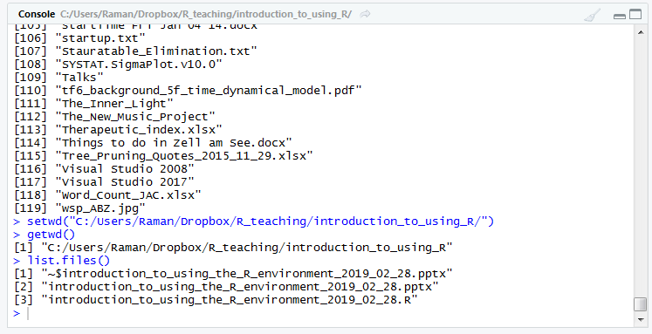
Setting working directory
Paste into “yourpath2” space in setwd() function.
Replace all back-slashed with forward-slashes (Windows):
> setwd(“yourpath”)
> getwd() # confirm location
> list.files() # files in location

Slide 23
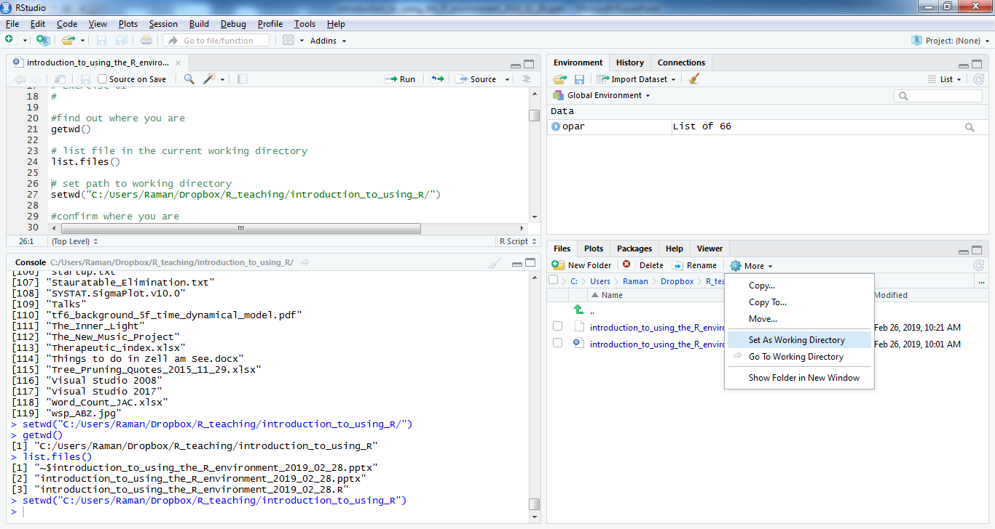
You can navigate to directory via files tab and
then as working directory, using more of the drop
down menu

Slide 24
Variables/Objects in R
R has a wide variety of modes: numerical, character, logical.
R has a variety of data types including scalars, vectors, matrices, data frames, and lists.
Scalars are just one value: > a <- 3 (3 assigned to object named a)
“=“ or “<-” operators use to assign value to an object.
In function arguments have to be specfied with “arg_name =“.
Vectors, Matrices and Arrays: values stored in positions of a data structure with a certain length (vector), or length and width (matrix), or length, width and depth (array).
Data frame is more general than a matrix, in that different columns can have different modes (numeric, character, factor, etc.).

Slide 25
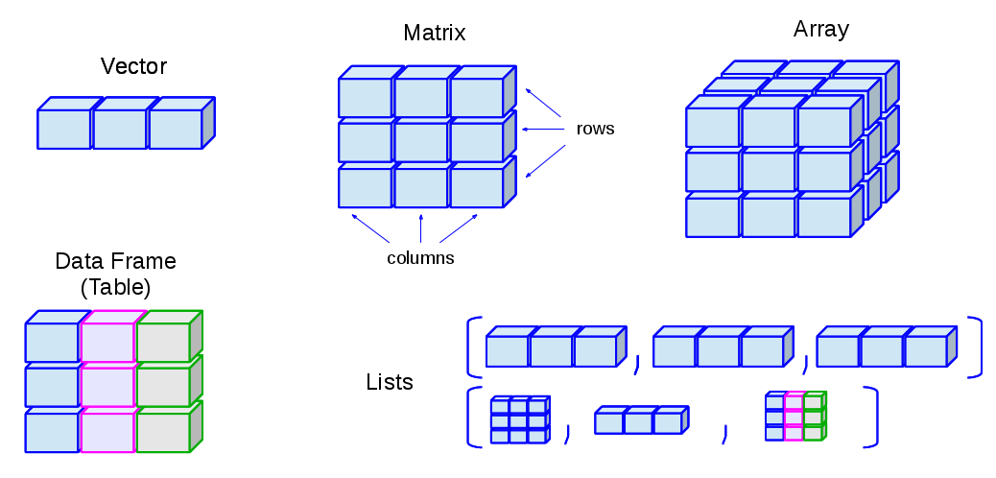
http://venus.ifca.unican.es/Rintro/dataStruct.html

Slide 26
c() function in R – it’s really useful…
c() function is combines/concatenates objects in a vector.
Specifying a vector of numerical values:
> num_vec <- c(1,2,3,4,5) # store integers 1 to 5
> num_vec
> num_vec2 <- c(1:5) # same as above, stores 1 to 5
> num_vec2
Used for specifying multiple argument for functions/subsetting data:
> #legend(x = 25,y = 110,legend = c("drug X","drug Y"))
# plot a legend on a graph with two names (not executed)
> num_vec[c(1,5)] # get first and fifth element of num_vec

Slide 27
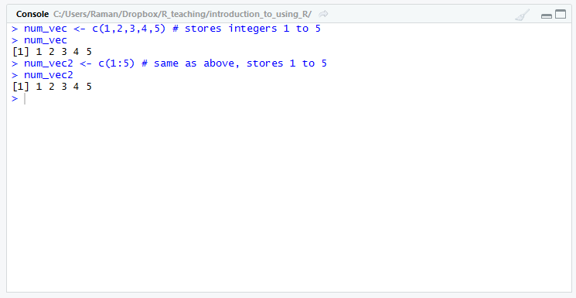

Slide 28
Numerical Operations in R
You can perform numerical operations on scalar, vector, matrix and dataframe objects:
> a <- 3; b <- 5 # scalars
> i <- c(1,2,3) # vector
Add together scalar objects and assign to “sum_ab” object:
> sum_ab <- a +b > sum_ab
> sum_ab
Multiply all elements of vector i by 3:
> triple_i <- i*3
> triple_i

Slide 29
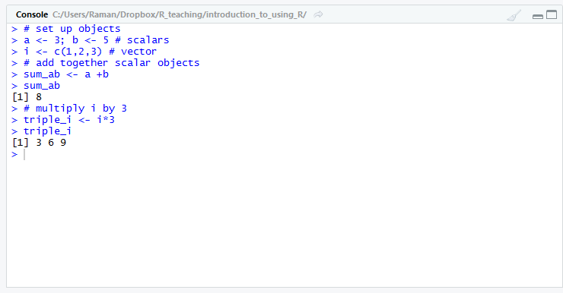

Slide 30
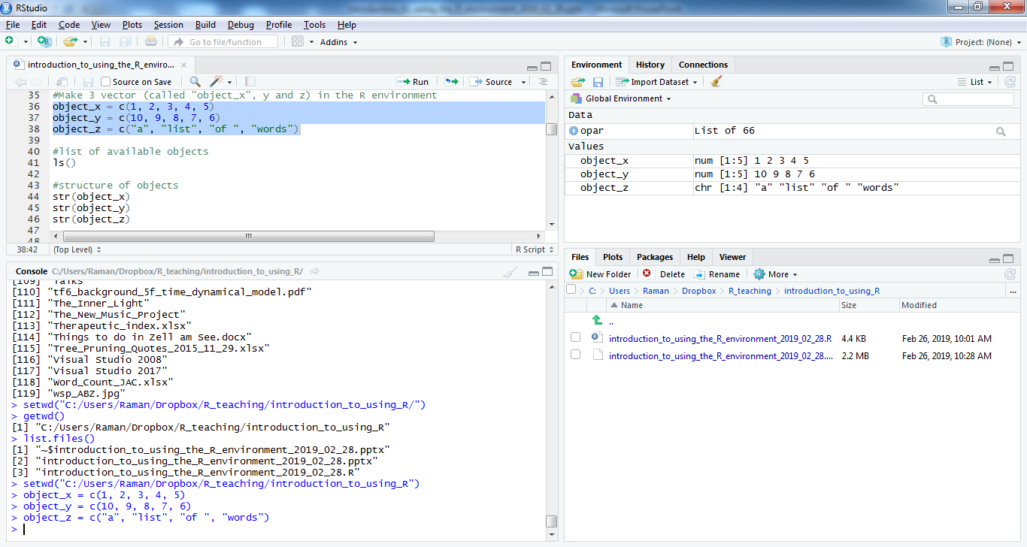
In R, you can load data from an external file (later), but you can also create ‘objects’ (that hold different kinds of data) directly.
Make 3 objects (called “object_x”, y and z) in the R environment via command line console:
> object_x = c(1, 2, 3, 4, 5)
> object_y = c(10, 9, 8, 7, 6)
> object_z = c(“a”, “list”, “of ”, “words”)

Slide 31
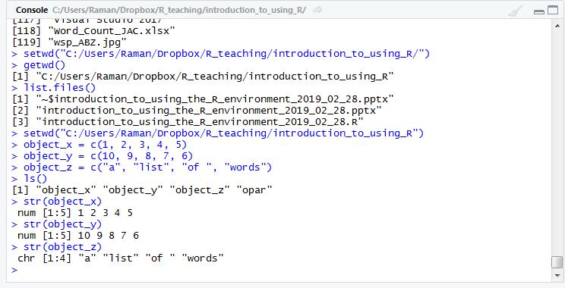
List available objects:
> ls()
Interrogate the structure and summarise the data in the objects:
> str(object_x)
> str(object_y)
> str(object_z)

Slide 32
Created objects also listed in “Environment”
window, as is their structure…

Slide 33
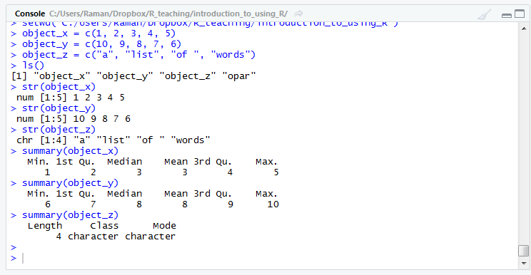
Summary statistics for each object (dependent on variable type/mode):
> summary(object_x)
> summary(object_y)
> summary(object_z)
No equivalent “button” in Rstudio…

Slide 34
Other useful functions for interrogating data:
> mean(); sd()
> median(); quantile()
> dim(); length()

Slide 35
Accessing specific elements in a vector
Square brackets indicate position in the a vector:
vec[n] is the nth element in vector vec
Can save specific elements of vectors to other vectors:
object_z2 <- object_z[2] # save element 2 object_z to # object_z2
object_z2
A range of elements in an object can be accessed:
object_z[2:3] # elements 2 to 3 of vector object_z

Slide 36
Plotting Objects…
Plot two numerical objects (object_x and object_y)
> plot(x=object_x, y=object_y,main = "Y against X",xlab = "x value",ylab = "y value“,type=“b”)
We added a title and x and y axis labels.
Also specified that we would like to plot both lines and points. Default point type (circle, no fill).
Default colour is black.

Slide 37
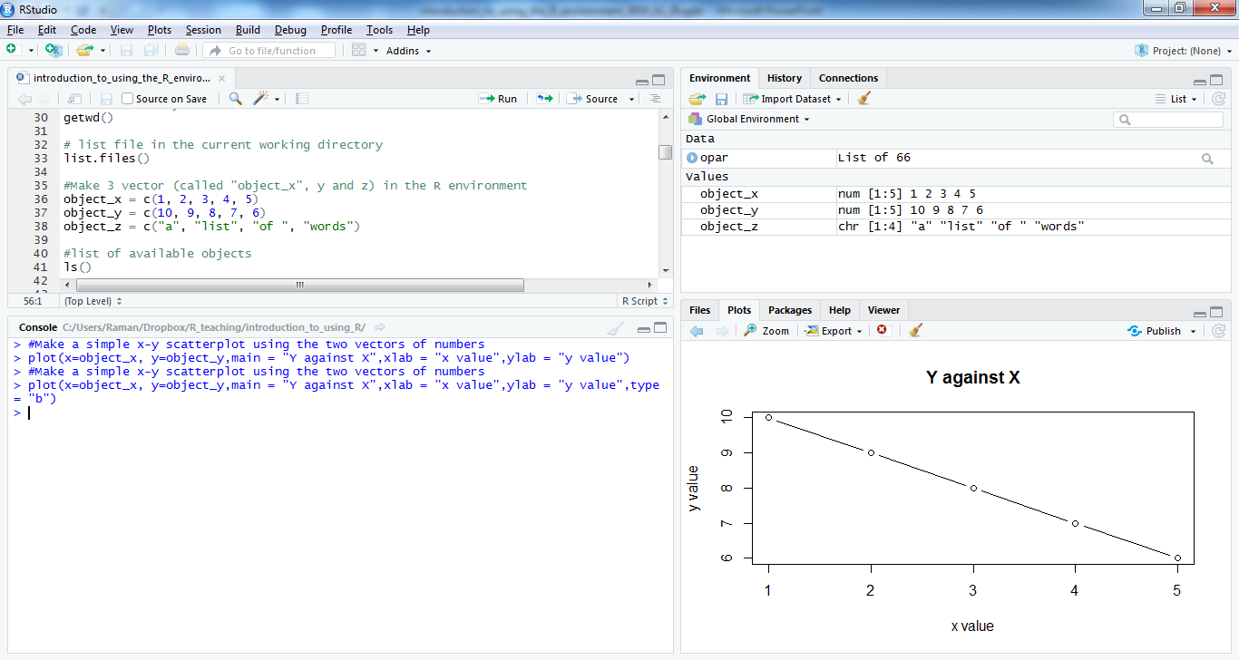

Slide 38
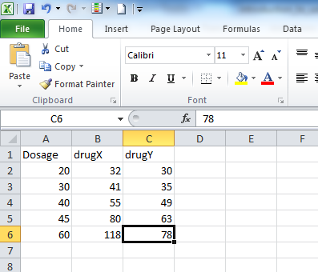
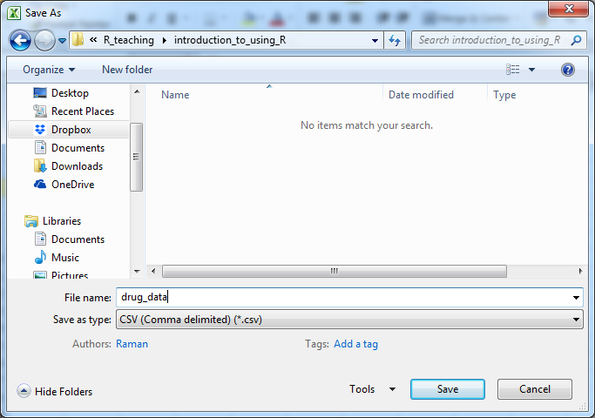
Exercise 1b: Creating datasets: via Excel
Create data set and save as CSV file: Drug active vs. Dosage.

Slide 39
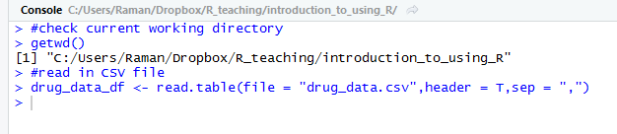
Reading in created datasets…
Files can be read into a dataframe object.
A dataframe is a two-dimensional objects where rows are a individual data entry and columns can be any type of vector (numeric, character) representing the properties of that data point…
Check location and read in drug_data.csv into dataframe:
> getwd()
> drug_data_df <- read.table(file = "drug_data.csv",header =T,
sep = ",")

Slide 40
Writing out a dataset.
Some times you would like to write out data that you have manipulated or just make a copy.
You write out data frames as CSV or Tab delimited files easily in R.
> write.table(x= drug_data_df ,file=“drug_data_copy.csv”, sep=“,”,col.names=T,row.names=F) # write out CSV
> write.table(x= drug_data_df ,file=“drug_data_copy.txt”, sep=“\t”,col.names=T,row.names=F) # write out tab # delimited file

Slide 41
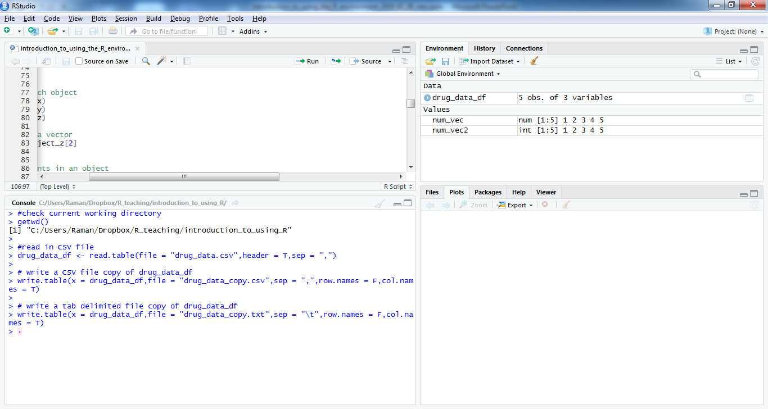
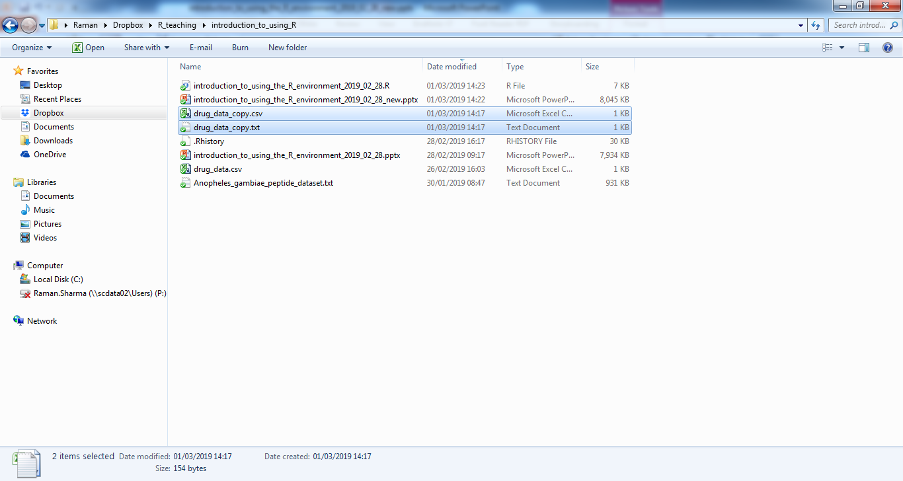

Slide 42
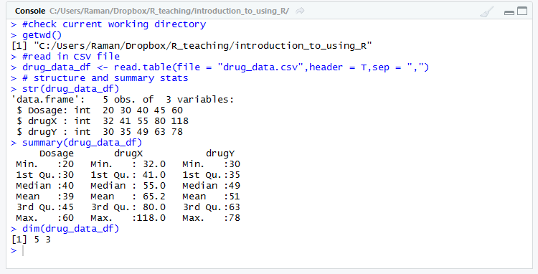
Examine dataframe just loaded:
> str(drug_data_df)
> summary(drug_data_df)
> dim(drug_data_df)

Slide 43
Plot activity Vs. dosage for both drugs (example of a fully set up plot)
Plot drug X with title, axis labels, type and point definitions:
> plot(x = drug_data_df$Dosage,y = drug_data_df$drugX,main="Drug activity vs. Dosage",xlab="Dosage (mg/Kg)",ylab = "Activity",type="b",pch=15)
Add drug Y plot to same graph with red solid triangular points:
> lines(x = drug_data_df$Dosage,y =
drug_data_df$drugY,type = "b",col="red",pch=17)
Add legend to plot with right colours and point types:
> legend(x = 25,y = 110,legend = c("drug X","drug Y"),col = c("black","red"),pch=c(15,17))
Can change size, colour and format of all plot elements.

Slide 44
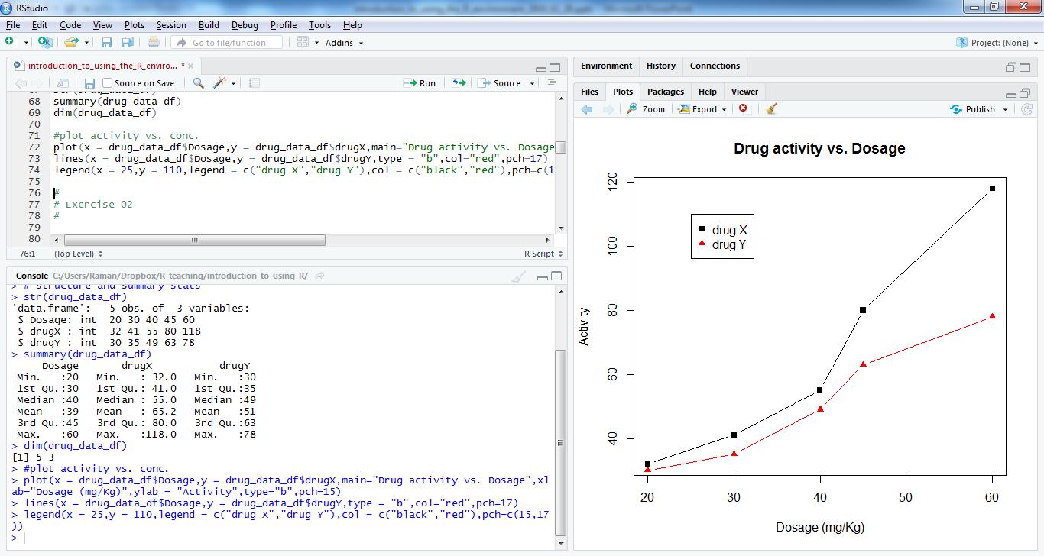

Slide 45
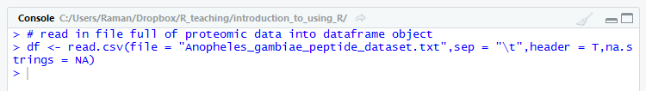
Exercise 2: Reading in and manipulating complex data
A tab delimited file contains amino acid counts for various mosquito genes for a resistant phenotype.
Read tab delimited file into a dataframe:
> df <- read.csv(file = "Anopheles_gambiae_peptide_dataset.txt",sep = "\t",header = T,na.strings = NA)

Slide 46
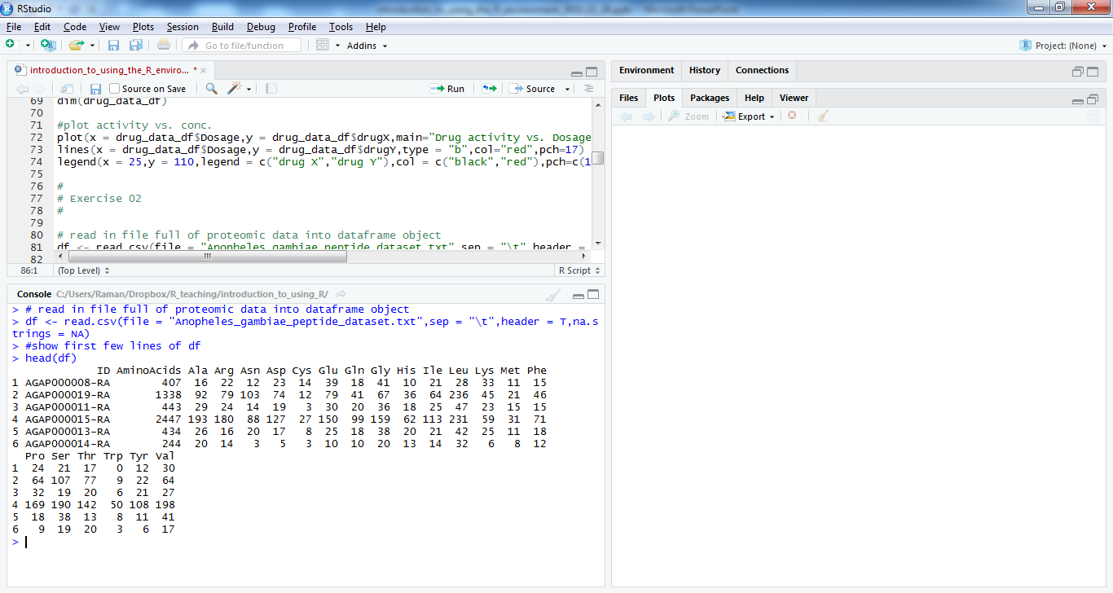
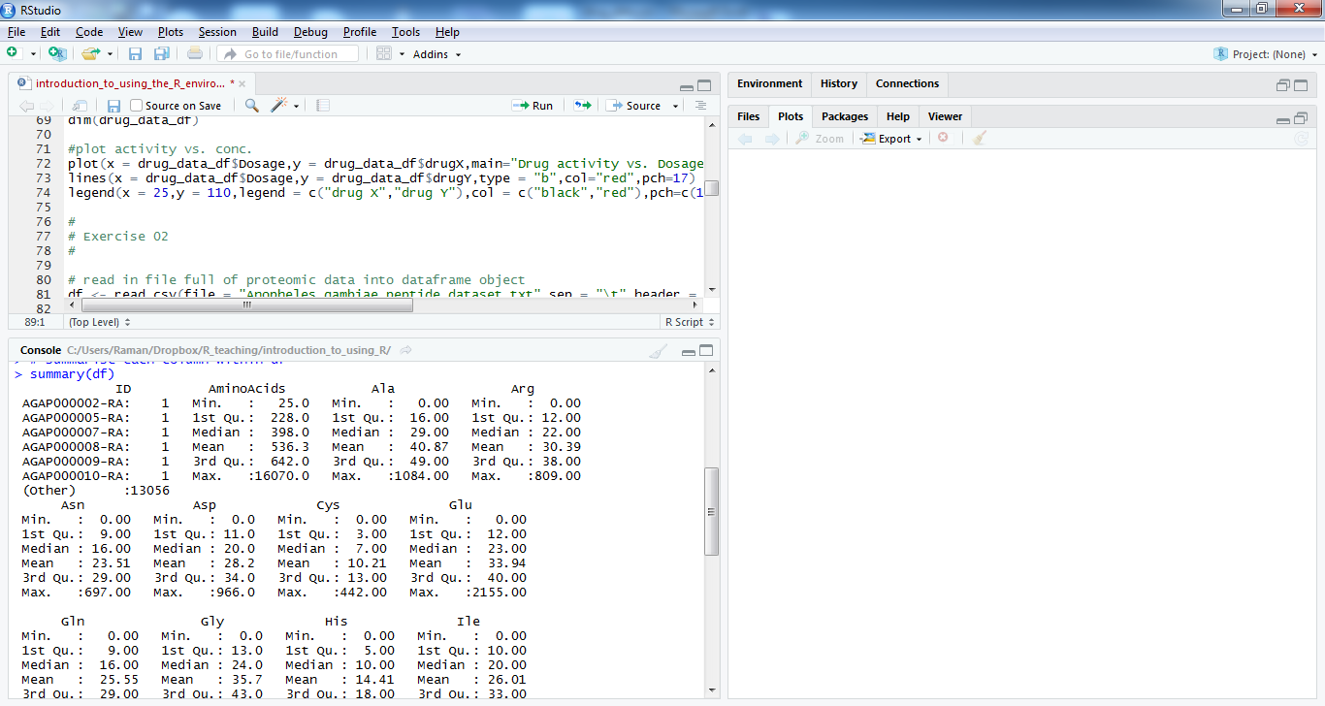
Examine complex data set:
Show first 6 line of dataframe df:
> head(df)
Summary statistics for df:
> summary(df)

Slide 47
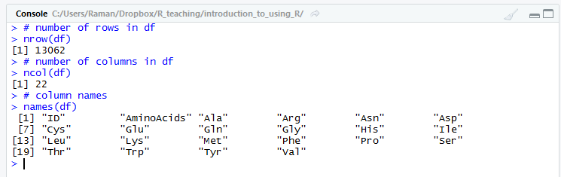
Querying the proportions dataframe:
Number of columns and rows in df:
> ncol(df)
> nrow(df)
Column names:
> names(df)

Slide 48
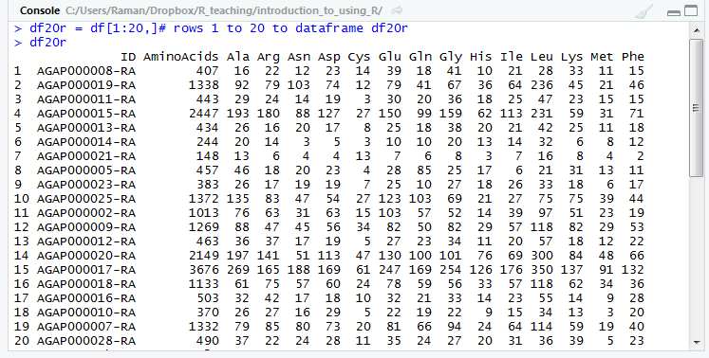
Sub-setting a dataframe by column/row name/number:
Columns of dataframe can be referred to by dataframe$coulmn or column number syntax.
Rows can be referred to by a unique ID column (you have to create) or row number.
Subset data by column or row:
> df$AminoAcids # pick column named AminoAcids.
> df20r = df[1:20,]# rows 1 to 20 to dataframe df20r
> df[1:100,] # means "row 1 to 100 and all columns of df"
> df[2, 1:3] # means "row 2 and columns 1 to 3 of df"
>df[c(1,10,12),] # means "row1, 10 and 12 and all columns of df“

Slide 49
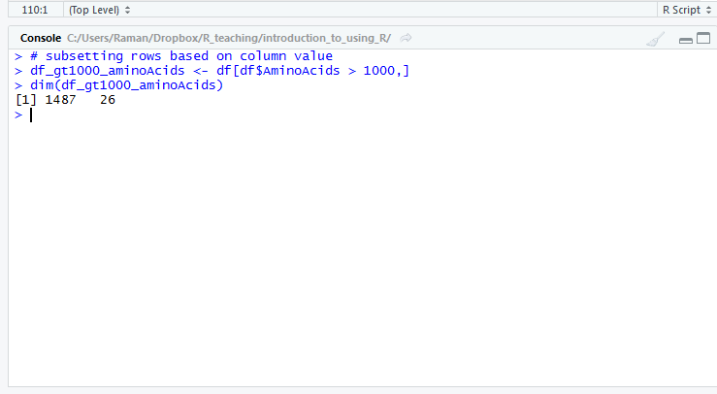
Sub-setting dataframe rows by value of column:
Subset df to df_gt1000_aminoAcids for only those rows with > 1000 amino acids:
> df_gt1000_aminoAcids <- df[df$aminoAcids > 1000,]
> dim(df_gt1000_aminoAcids)
Smaller dataset after filtering (1487 row cf. 13026 originally):

Slide 50
Adding columns to a dataframe:
You can add columns to a dataframe easily, by specifying them like this:
> df$new = 0
> df$new
Add column that evaluates the proportions of Ala residues relative to the total number of proteins residues:
> df$Ala_proportion = df$Ala / df$AminoAcids
You can perform an numerical operation on entire columns with this syntax, multiple, divide, add, subtract columns from one another.
> df$aromatic_res = df$Phe + df$Tyr + df$Trp
> df$aromatic_proportion = df$aromatic_res/df$AminoAcids

Slide 51
Exercise 3: Complex data exploration and plotting
Load dataset from Exercise 2.
Graphical parameters stored in par() object.
> par()
Store default graphical parameters for restoring later:
> opar <- par(no.readonly=TRUE)
Set number of plots on one page:
> par(mfrow=c(1,1))
Scatterplot with title, axis labels and default data point style:
> plot(x=df$aminoAcids, y=df$Leu,main=“Leucine Vs. Amino acid Counts”,xlab=“Amino Acid Count”,ylab=“Leucine Count”)
place horizontal line at 250 on the vertical axis
> abline(h=250,col="red")

Slide 52
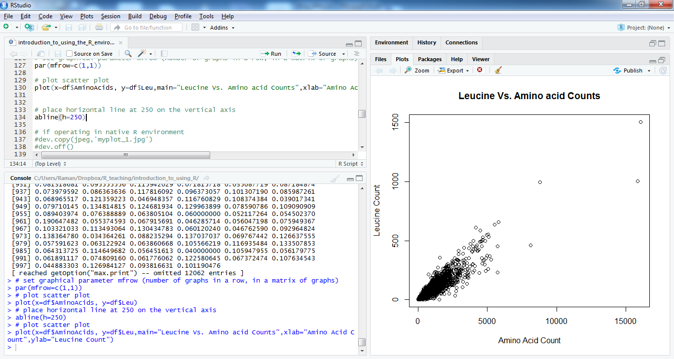

Slide 53
Plotting axes on a log-scale
Some data/variables are best viewed on a log-scale:
Parasite densities.
Drug concentrations.
qPCR outputs.
You can choose to plot data on a log scale in plot with the “log=“ argument but have to be careful of 0 values as log(0) = ∞.
Can create new column which adds 1 to all column values and then plot this value:
> df$log_AminoAcids_plusOne <- log10(df$AminoAcids+1)
> plot(x=df$log_AminoAcids_plusOne,y=df$Leu,log=“x”)

Slide 54
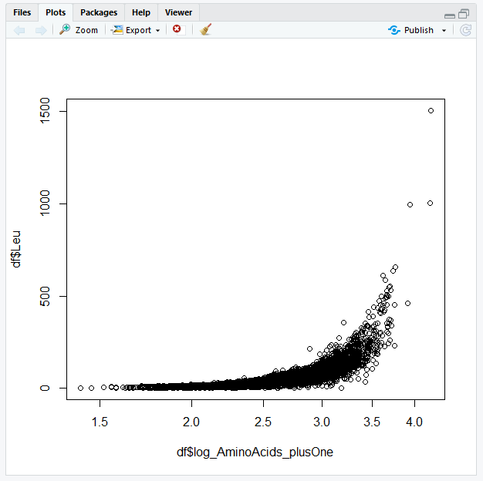

Slide 55
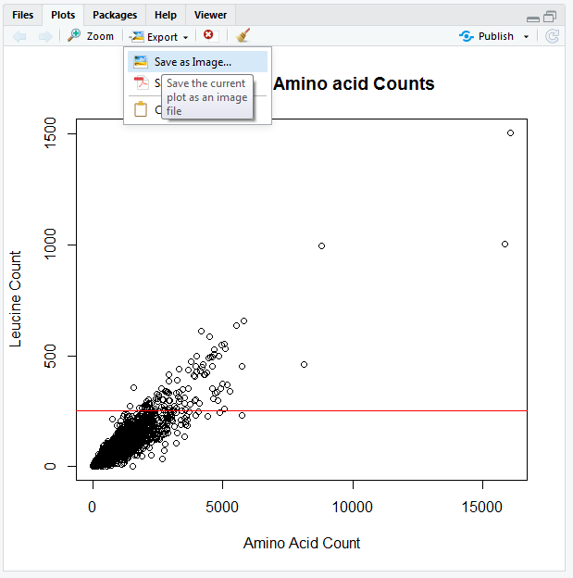
Add additional things to the plot (more data, axes, lines, text etc. Here we will add a red horizontal line at position 250 on the y axis)
> plot(x=df$aminoAcids, y=df$Leu,main=“Leucine Vs. Amino acid Counts”,xlab=“Amino Acid Count”,ylab=“Leucine Count”)
> abline(h=250,col=“red”)
Save plot via “export” button in
plots tab.
Easier than in native R.

Slide 56
Arranging multiple plots side-by-side, or one-above-another
> par(mfrow=c(1,2))
> plot(x=df$AminoAcids, y=df$Leu)
> plot(x=df$AminoAcids, y=df$Ala)
mfrow=c(1,2) means arrange plot area with one row and two columns.
Other examples:
mfrow=c(1,1) means arrange plot area with one row and one column.
mfrow=c(2,1) means arrange plot area with two rows and one column.
mfrow=c(3,2) means arrange plot area with three row and two columns.

Slide 57
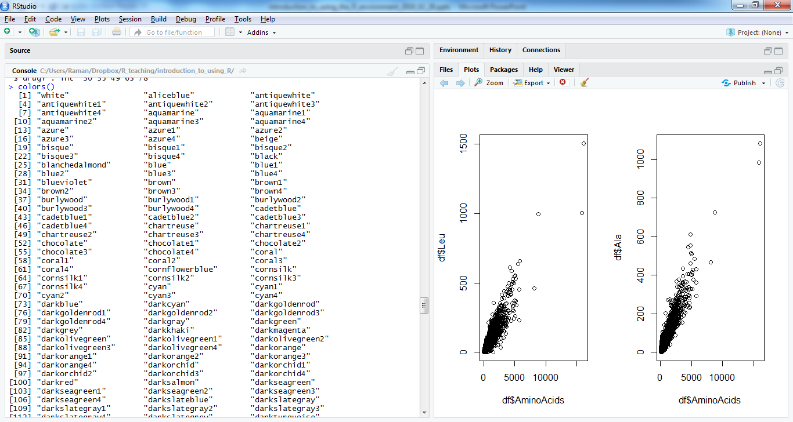

Slide 58
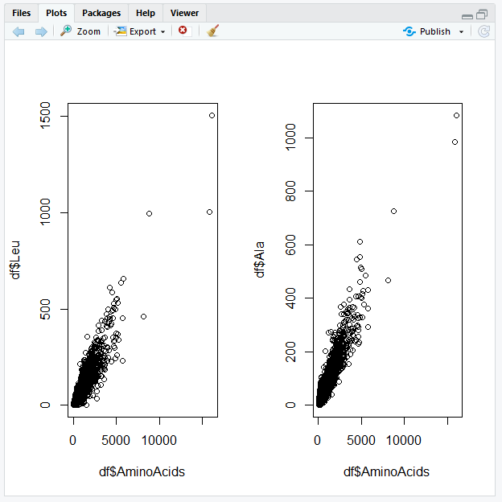

Slide 59
Controlling the data point character (pch), size (cex) and colour (col):
A useful website that shows all of the available characters can be found here:
https://www.statmethods.net/advgraphs/parameters.html
To change the appearance of the data points, use the pch argument the plot() function.
The cex argument controls the size of things (points, title text, axis label text etc.). 1 is the default size, greater than 1 for bigger points and less than 1 for smaller points.
The colour of the data points can be controlled using the col argument. The colour can be specified either by a number or by a name in double quotes (e.g. col=”black” or col=1).
Find all available colour names by typing:
> colours()

Slide 60
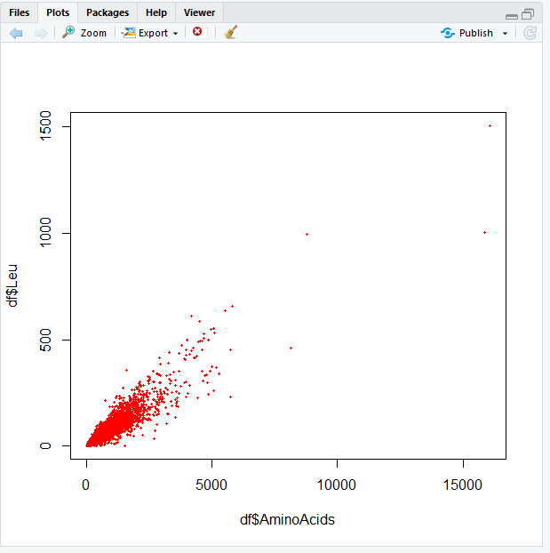
Example format: small filled red circles (col=“red”, pch=19, cex=0.4).

Slide 61
Controlling the text in a plot:
Three elements of text in your plot:
1. The main title.
2. The axis labels.
3. The numbers along the axes.
To set a main title in large red text, you could use”:
> plot(x=df$AminoAcids,y = df$Leu,main="Title Text",cex.main=2,col.main="red")

Slide 62
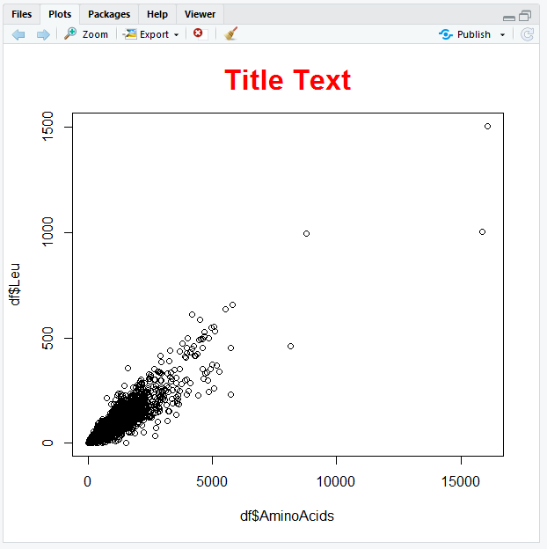
Main title text customisation:

Slide 63
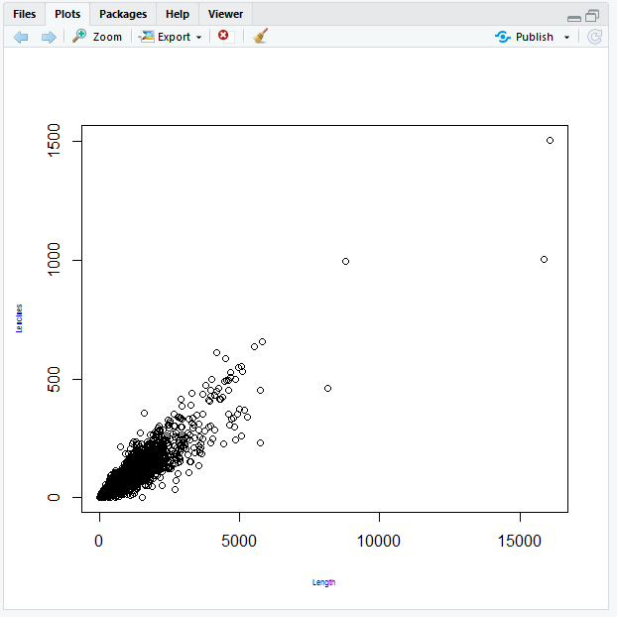
Axis label customisation:
To set your own x and y labels in small (half size), blue text:
> plot(x = df$AminoAcids,y = df$Leu,xlab="Length",ylab = "Leucines",cex.lab=0.5,col.lab="blue")

Slide 64
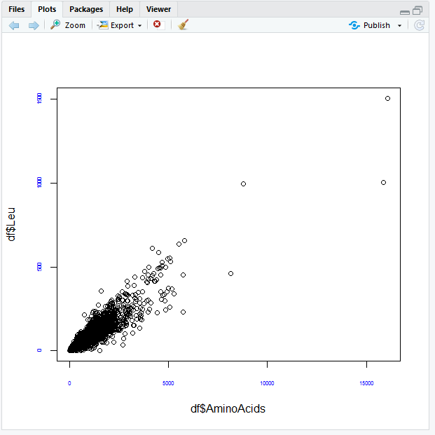
Axis number text customisation:
Scatterplot with blue axis numbers at half the default size
>plot(x=df$AminoAcids, y=df$Leu, cex.axis=0.5, col.axis="blue")

Slide 65
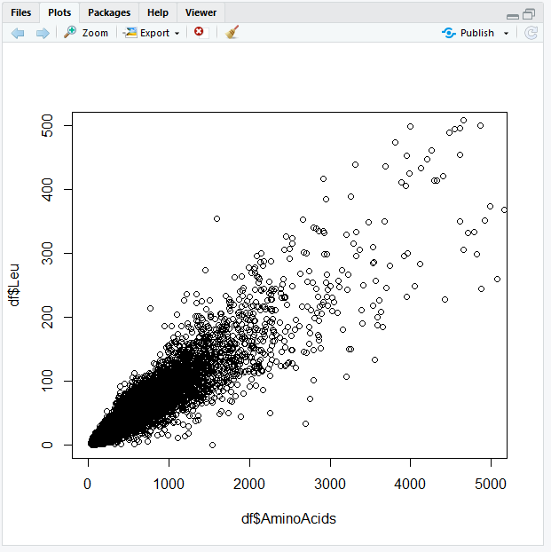
Changing axis ranges:
Re-scaling a plot to show data within a certain range:
> plot(x=df$AminoAcids, y=df$Leu, xlim=c(0,5000), ylim=c(0,500))

Slide 66
Customising axes:
First, make a plot without axes using the argument axes=F.
> plot(x=df$AminoAcids, y=df$Leu, xlim=c(0,5000), ylim=c(0,500), axes=F)
Now, add an x-axis (“side=1” means the bottom of the plot)
> axis(side=1)
Now add y-axis (“side=2”). Here, we will control what is displayed (labels), where along the axis (at) and the direction of the text (las=1, rather than las=0):
> axis(side=2, at=c(0,250,500), labels=c(0,250,500), las=1)

Slide 67
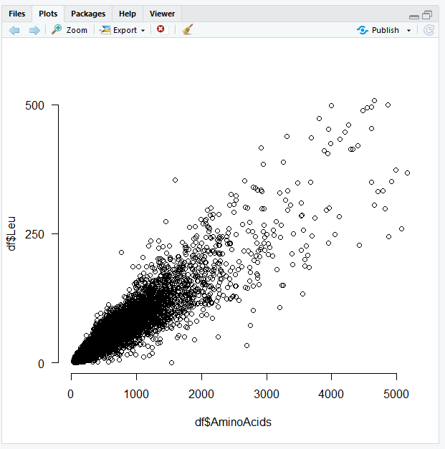

Slide 68
Simultaneous plotting of data, legends and lines:
Add Valine points (red circles) to Leucine graph (black circle):
> plot(x=df$AminoAcids, y=df$Leu, col="black")
> points(x=df$AminoAcids, y=df$Val, col="red")
Add legend with colour of points shown:
> legend(x=0, y=1000, legend=c("Leu","Val"), pch=1, col=c("black","red"))
Try other different positions of legend
> legend(x=12000, y=1000, legend=c("Leu","Val"), pch=1, col=c("black","red"))
> legend(x=12000, y=1500, legend=c("Leu","Val"), pch=1, col=c("black","red"))
Add additional dashed (lty=2) horizontal and dotted vertical lines (lty=3) to plot and alter line widths using lwd argument:
> abline(h=100, lty=2, lwd=4, col="red")
> abline(v=200, lty=3, lwd=0.5, col="blue")

Slide 69
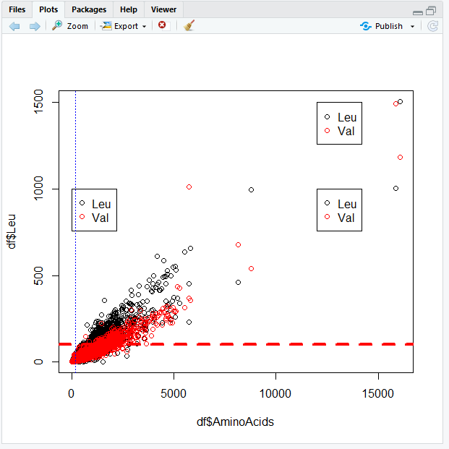

Slide 70
Histograms: Another common plot type
Plot histogram of frequencies with red bars and title:
> hist(df$AminoAcids,col = "red",main = "Histogram of Amino Acids in Protein",freq = T)
Display vertical line at maximum amino acid count value
> AminoAcids_Max = max(df$AminoAcids)
> abline(v = AminoAcids_Max)

Slide 71
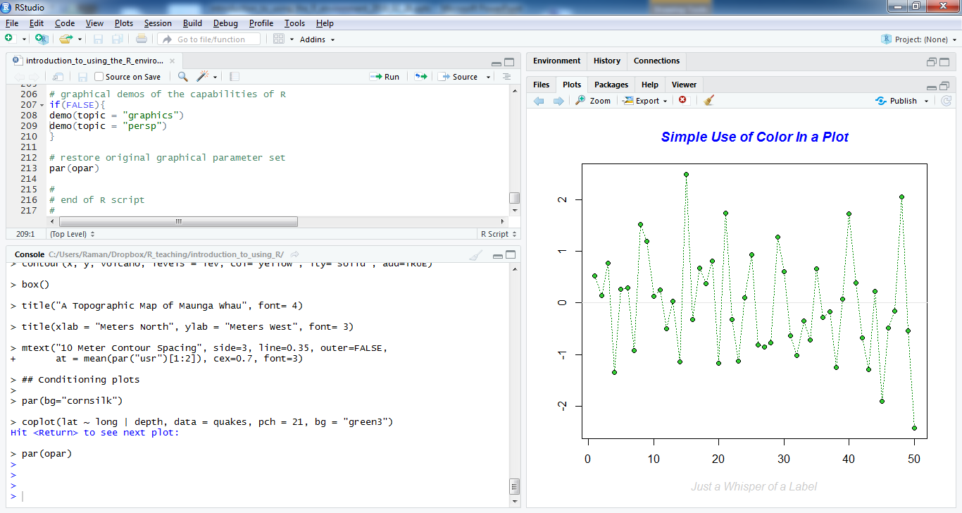





Other plot types…
For examples of the plotting capabilities of R (with code shown):
> demo(topic=“graphics”)
> demo(topic=“persp”)

Slide 72

Getting help with R: The help tab…

Slide 73
Getting help with R
help() function or ? Command
> help(ls) or ?ls # help for ls() function.
https://lstmed.sharepoint.com/research/RDM/rcu/Pages/R/Coding-with-R.aspx
https://www.rstudio.com/online-learning/
Quick-R: https://www.statmethods.net/
The R website https://www.r-project.org/
A bit more nerdy: http://venus.ifca.unican.es/Rintro
Google and stack overflow for specific issues.

Slide 74
Acknowledgements
Scientific computing team:
Simon Wagstaff
Andy Bennett
Demonstrators:
TBC
Some of the course materials adapted from/based on material from:
Gareth Weedall

